Slide 1
The Zen of Coding
Lesson 1.1

Slide 2
Quick Introductions
(30 seconds)
What’s your name?
Where are you from?
What’s your background (career, education, interests)?
Why do you want to learn web development?
Are you excited about the course?
Notes:
This class is, after all, about you – so let’s do some introductions.
(You may also want to ask “Fears about class?” – that can turn a little negative, so be ready to dissuade/make happy the students if you do ask this)

Slide 3
The Path of Learning

Slide 4

Your Goals
Basically, 100% of you said new career.
Notes:
shutterstock_520041586

Slide 5
Your Goals
And why do you want a new career?
To pursue a dream
To escape a dead-end job
To be able to create
To follow a fascination
To attain financial stability
To obtain financial freedom
To challenge yourself
To be a role model for your family

Slide 6
Your Goal = Our Goal
As instructional staff, we take your goals very, very seriously.

Slide 7
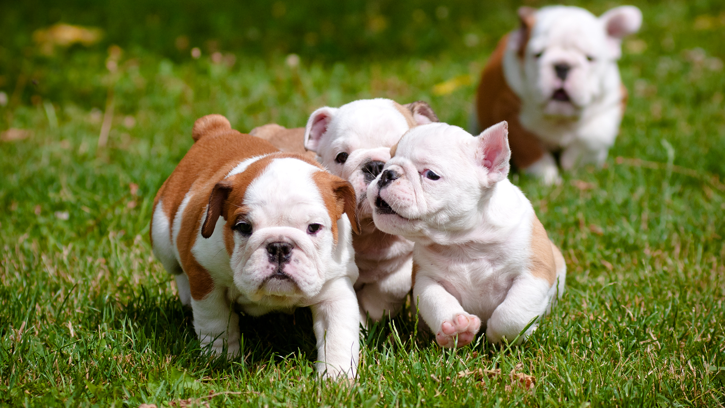
Support Team Promise
If you’re willing to put in the time and take our advice, we’re here to help you 100% of the way.
This goes for everyone working on this program:
Instructor
TAs
Student Success Team
Career coaches
University of Denver
Everyone else!
Notes:
shutterstock_137111177

Slide 8
But Remember:
Nothing good comes easily.

Slide 9
Our Keys to Success

Slide 10

Don’t Be This Person:
Notes:
Shutterstock_654566557

Slide 11

This Should Be You:
Notes:
Shutterstock_667830277

Slide 12
Our Mantra for Today and Beyond
When it comes to web development…

Slide 13
I know nothing.

Slide 14
You.

Slide 15
The Path of Learning

Slide 16
Nothing good comes easy.
As students, you’ll face these three HUGE obstacles.

Slide 17

Obstacle #1: The Great Confusion
My code doesn't work and I don't know why.
My code works and I don't know why.
Notes:
Shutterstock_1188695488

Slide 18

Obstacle #2: The Great Doubt
“Maybe I’m just dumb.”
Notes:
Shutterstock_215771662

Slide 19

Obstacle #3: The Great Distance
Notes:
Shutterstock_411452953

Slide 20
Nothing Comes Easy
Learning to code requires two things:
01
Persisting in the face of something that will (at times) feel difficult, overwhelming, and confusing.
02
Maintaining the self-confidence and resilience necessary to trust that YOU CAN DO THIS.

Slide 21

Learning Can Be Frustrating
You can’t tell whether you’re learning something when you’re learning it—in fact, learning feels a lot more like frustration.
What I’ve learned is that during this period of frustration is actually when people improve the most, and their improvements are usually obvious to an outsider. If you feel frustrated while trying to understand new concepts, try to remember that it might not feel like it, but you’re probably rapidly expanding your knowledge.
—Jeff Dickey, author of Write Modern Web Apps with the MEAN Stack: Mongo, Express, AngularJS, and Node.JS (Peachpit Press, 2014)

Slide 22
Advice for the Journey
Throughout this course, always remember to:
03
Trust yourself
Work hard!
01
02
Celebrate your successes

Slide 23
Advice for the Journey
Throughout this course, always remember to:
03
Trust yourself
Work hard!
01
02
Celebrate your successes

Slide 24
Advice for the Journey
Throughout this course, always remember to:
03
Trust yourself
Work hard!
01
02
Celebrate your successes

Slide 25
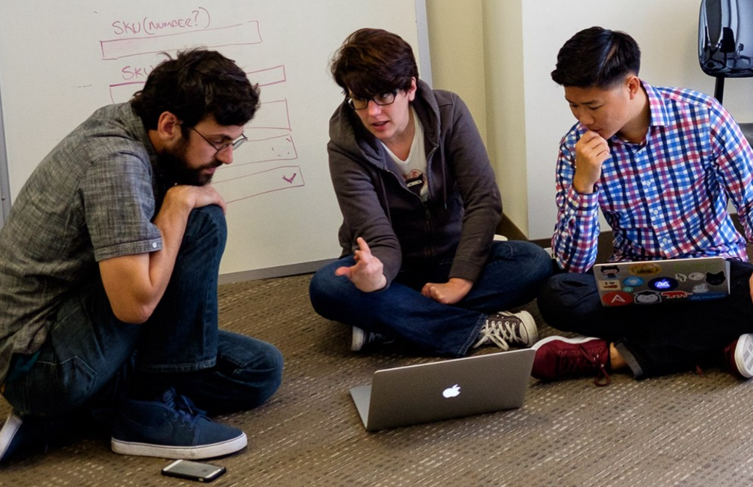
And Remember...
If you want to go fast, go alone. If you want to go far, go with a team.
Notes:
This is a Trilogy image of students and does not violate copyright laws.

Slide 26

Google Fu: The Most Important Skill of All
What Is Google Fu?
Notes:
shutterstock_653127499

Slide 27
Course Structure

Slide 28
Daily Schedule
In each class, we’ll cover some or all of the following:
Set the daily objectives
Brief background lecture
Watch me/coding demos (code along when possible!)
Code discussions
In-class exercises
Project work

Slide 29

Daily Schedule
In each class, we’ll cover some or all of the following:
Set the daily objectives
Brief background lecture
Watch me/coding demos (code along when possible!)
Code discussions
In-class exercises
This is the super important stuff—ALWAYS BE CODING!
Project work

Slide 30
Prework

Slide 31

<title>Intro to HTML</title>
How’d it go?

Slide 32
Software Checklist
At this point, you should have all of these installed:
Slack
Visual Studio Code
Git
Git Bash (Windows) or Terminal (Mac)
Node.js
Heroku-CLI
Google Chrome

Slide 33
Accounts Checklist
You should also have accounts for:
GitHub (with SSH Integration)
Heroku
LinkedIn
Stack Overflow

Slide 34
Self-Check
Let’s do some quick checks of the following:
Visual Studio Code Check
Git Bash/Terminal Check
Node Check
Git Check
Heroku Check

Slide 35
The Modern Web

Slide 36

What Exactly Is Full-Stack Development?

Slide 37

The “Magic” of YouTube
Notes:
shutterstock_1024261021

Slide 38




Full-Stack Development
FSF FLOW
In modern web apps, there’s a constant back-and-forth communication between two key systems: the visuals displayed in the user’s browser (front-end) and the data and logic stored on the server (back-end).
Browser shows webpage to user
Web browser
Front-end
User requests a webpage
Browser talks to Express
Express sends HTML back to browser
MySQL database
Node sends SQL
Node.js Express.js
Back-end
MySQL returns rows
Node passes data to Handlebars
Handlebars renders HTML
Handlebars

Slide 39
Full-Stack Development
FSF FLOW
Full-stack development is the concept of building every aspect of the web application— from the visuals and interactions to the data transfer and processing.
Browser shows web page to the user
Web bowser
Front-end
User requests a web page
Browser talks to Express
Express sends HTML back to browser
MySQL Database
Node sends SQL
Node.js Express.js
Back-end
MySQL returns rows
Node passes data to Handlebars
Handlebars renders HTML
Handlebars

Slide 40
Full-Stack Development
The Browser | Dev Tools | Server Side
HTML | Heroku | Templating engines
CSS | Git | Sessions
JavaScript | GitHub | Writing tests
jQuery | Databases | Node.js
Bootstrap | MySQL | Express.js
SEO | MongoDB | ORMs (Sequelize)
API Interaction |  | ODMs (Mongoose)
APIs (Consuming) |  | MVC
JSON |  | User authentication
AJAX |  | CS Fundamentals
Creating APIs |  | Algorithms
Cutting-Edge Development |  | JavaScript Data Structures
React.js |  | Big O Notation

Slide 41
Let’s Get Crackin’!

Slide 42

Intro to Console/Terminal

Slide 43
Let’s Get Crackin’—Intro to Console

Slide 44
Activity: Console Commands
Instructions sent via Slack.
10 minutes

Slide 45
Activity: Console Commands
Suggested Time: 10 min
Instructions:
01
Create a new folder with the name of self-destructing-folder.
02
Create a new txt file with the name secret-message.txt.
03
Copy secret-message.txt to the inside of self-destructing-folder.
Delete the original secret-message.txt file.
04
Delete the self-destructing-folder.
05

Slide 46

Intro to Console: Discuss with Neighbors
Notes:
shutterstock_81648802

Slide 47
Hello, HTML

Slide 48
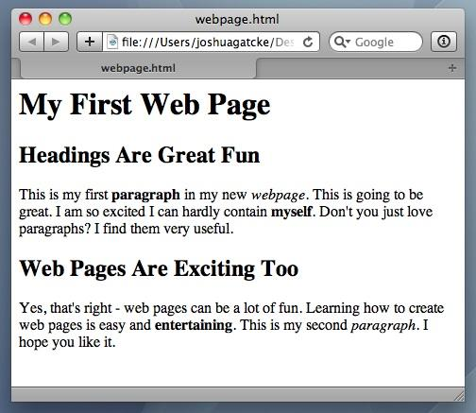
<title>Intro to HTML</title>
HTML5
HTML is one of the three base languages behind every website.
It defines all the basic content and a bit of formatting.
The Zen of Coding

Slide 49
Activity: Intro to HTML
Instructions sent via Slack.
5 minutes

Slide 50
Activity: Intro to HTML
Suggested Time: 5 minutes
In a new HTML file, create the basic structure of an HTML document and include the following in it:
DOCTYPE declaration
Head tag with a title tag
H1 tag with a title of your choice
An embedded image
Now add the following three links to your page:
One link that has target="_blank" so that it opens a new tab when clicked
One link that is bold
One link that is only a placeholder (it goes nowhere)
BONUS!
Create an ordered list of steps to make a sandwich
Create an unordered list of five bands/musicians you like
Create a table with two columns (animal class and animal name) and four rows of animals
Use an alternate way of separating links without line breaks
Embed a YouTube video of your favorite band/musician

Slide 51
My First HTML
Notes:
https://www.youtube.com/watch?v=ieb6Svbc10E&index=1&list=PLgJ8UgkiorCnMLsUevoQRxH8t9bt7ne14

Slide 53
What is Git?

Slide 54












Collaborative Coding
Modern web development is highly collaborative.
Teams are often extremely large and spread out across the country or world.
Apps are often made up of hundreds or thousands of files.
Git Version Control
Final
Originals
Change Requests
Developers

Slide 55

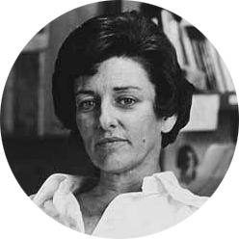
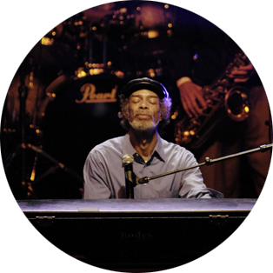
The Team’s Task
Make a list of creative works you’ve written in the past.
Programming Team
Maya Angelou | Anne Sexton | Gil Scott Heron

Slide 56

Maya & Gil Make Their Edits
Maya Angelou is programming away.
Maya Angelou’s version
<ul>
<li>On the Pulse of Morning</li> <li>I Know Why the Caged Bird Sings</li> <li>And Still I Rise</li>
</ul>
Gil Scott Heron is programming away.
Gil Scott Heron’s version
<ul>
<li>Free Will</li> <li>Pieces of a Man</li> <li>The Revolution Will Not Be Televised</li>
</ul>

Slide 57

Different Solutions
Maya Angelou’s version
Gil Scott Heron’s version
<ul>
<li>On the Pulse of Morning</li> <li>I Know Why the Caged Bird Sings</li> <li>And Still I Rise</li>
</ul>
DIFFERENT
<ul>
<li>Free Will</li> <li>Pieces of a Man</li> <li>The Revolution Will Not Be Televised</li>
</ul>

Slide 58
Resolution
Maya Angelou’s version
Let’s settle on this:
<ul>
<li>Poems</li>
<li>Albums</li>
<li>Songs</li>
</ul>
<ul>
<li>On the Pulse of Morning</li> <li>I Know Why the Caged Bird Sings</li> <li>And Still I Rise</li>
</ul>
Gil Scott Heron’s version
<ul>
<li>Free Will</li> <li>Pieces of a Man</li> <li>The Revolution Will Not Be Televised</li>
</ul>

Slide 59
Anne Sexton Writes Her Own Version
Anne Sexton’s version
<ul>
<li>The Double Image</li>
<li>Heart’s Needle</li>
<li>Baby Picture</li>
</ul>

Slide 60
Anne Sexton Overwrites the Work of Her Teammates
Delete. Delete.
Delete. Delete.
Delete. Delete.
<ul> <li>Poems</li> <li>Albums</li> <li>Songs</li> </ul> | <ul> <li>The Double Image</li> <li>45 Mercy Street</li> <li>The Road Back</li> </ul>

Slide 61

The Group Project
Lesson: You should use version control because it helps you manage multiple developers (with their respective changesets) working on a single codebase.
“Today we fret and pull on wheels, ignore our regular loss of time…” Or maybe we should just use Git.

Slide 62
Git Version Control
Git provides an organized system for managing code when multiple developers work on a project at the same time.
The Benefits of Git
01
A process for resolving conflicts in code
02
Version history

Slide 63
The Group Project
Branch = personal copy
Master Branch
Personal Branches
Maya’s Personal Branch
Anne’s Personal Branch
Gil’s Personal Branch

Slide 64
The Team Goes to Work
Maya Angelou’s version
<ul>
<li>On the Pulse of Morning</li>
<li>I Know Why the Caged Bird Sings</li>
<li>And Still I Rise</li>
</ul>
Gil Scott Heron’s version
<ul>
<li>Free Will</li>
<li>Pieces of a Man</li>
<li>The Revolution Will Not Be Televised</li>
</ul>

Slide 65

Maya Angelou Pushes First
Maya Angelou pushes (uploads) her code changes into the main branch.
No code conflicts
1
Master Branch
Maya’s Personal Branch

Slide 66
Rule: Pull (download) first, and then push (upload) your changes.

Slide 67
Gil Scott Heron’s Edits Are Ready
Rule: Pull first, and then push your changes.
1
Master Branch
Gil’s Personal Branch

Slide 68

Gil Scott Heron Conflicts with the Master Branch
Git sees a conflict.
<ul>
<li>On the Pulse of Morning</li>
<li>I Know Why the Caged Bird Sings</li>
<li>And Still I Rise</li>
<li>On the Pulse of Morning</li>
<li>I Know Why the Caged Bird Sings</li>
<li>And Still I Rise</li>
</ul>
1
Master Branch
Gil’s Personal Branch

Slide 69
Gil Resolves the Conflict
<ul>
<li>On the Pulse of Morning</li>
<li>I Know Why the Caged Bird Sings</li>
<li>And Still I Rise</li>
<li>On the Pulse of Morning</li>
<li>I Know Why the Caged Bird Sings</li>
<li>And Still I Rise</li>
</ul>
<ul>
<li>Poems</li>
<li>Albums</li>
<li>Songs</li>
</ul>
Gil’s Personal Branch

Slide 70
Gil Scott Heron Pushes His Code (Including the Revisions)
Gil pushes (uploads) his revision to the main branch.
No code conflicts
1
2
<ul>
<li>Poems</li>
<li>Albums</li>
<li>Songs</li>
</ul>
Master Branch
Gil’s Personal Branch

Slide 71
Anne Sexton Starts Her Work
Rule: Pull first, and then push your changes.
look into my face
and you will know that crimes dropped upon me
as from a high building…
…by which I mean, I broke the rules.

Slide 72
Anne Sexton Pushes
Anne Sexton pushes (uploads) her revision to the main branch, but she doesn’t pull (download) first. Because she did not pull first, she sees no conflicts in the code (and doesn’t get the rest of the team’s work!). This is NOT what we want.
1
2
3
Master Branch
<ul>
<li>The Double Image</li>
<li>Heart’s Needle</li>
<li>Baby Picture</li>
</ul>
Anne’s Personal Branch

Slide 73
If Anne Had Made a Pull First...
Conflict!
<ul>
<li>The Double Image</li>
<li>Heart’s Needle</li>
<li>Baby Picture</li>
</ul>
<ul>
<li>Poems</li>
<li>Albums</li>
<li>Songs</li>
</ul>
CONFLICT!

Slide 74
The overwritten work is discovered!

Slide 75
Roll Back
Maya rolls back the code to an earlier version.
x
1
2
3
4
Master Branch
x
Anne’s Personal Branch

Slide 76
Activity:
Explain Git (Version Control)
3 Minutes

Slide 77
Activity: Explain Git (Version Control)
Suggested Time: 3 Minutes
Turn to your neighbor, and have one of you explain to the other:
The concept of version control
Then, the other should explain:
Two key advantages of using a version control system

Slide 78
What Is GitHub?
GitHub is a web-based hosting service to store code online.
It allows developers to pull (download) code or push (upload) code to the same repository (directory).
It also allows developers to view histories of code changes and track issues.

Slide 79
Pushing and Pulling to GitHub
1
2
3
4
GitHub Branch
Pull Code
Push Code
Pull Code
Push Code
Pull Code
Push Code

Slide 80
Get Started with Git

Slide 81
Git (follow along if you can!)

Slide 82
Basic Git Commands
These are the five basic Git commands to get started:
git clone
git add
git commit
git push
git pull

Slide 83
Basic Git Commands
git clone | Copies an entire repo (to begin)
git add | Adds a file/set of files for inclusion in Git
git commit | Notes a set of changes to the local repo
git push | Sends changes to hosting service
git pull | Downloads freshest version of repo

Slide 84
Challenge: Git Add, Commit, Push
10 minutes

Slide 85
Activity: Git Add, Commit, Push
Suggested Time: 10 Minutes
Using GitHub and the command line:
Create a new public GitHub repository and name it whatever you like. Be sure to check the box to ‘Initialize this repository with a README.’
Clone the repo to your local directory.
Create an HTML file inside the local directory.
Add, commit, and push the code to GitHub.
Bonus:
Find a partner in class, and fork their repository to your own GitHub account. Clone this forked repository to your local directory.
Add, commit, and push the code back to your forked copy.
Submit a pull request to send your changes to your partner’s repo.

Slide 86

Still a Bit Lost? Don’t Worry!
Follow this handy guide!
Practice a few times on your own before the next class.
Notes:
Send out Steps To Upload to Github.pdf

Slide 87
If you’re still lost, here’s a course on how to use GitHub: https://www.pluralsight.com/courses/how-git-works (this site offers a free 10-day trial)

Slide 88
Before Next Class…
Next Class

Slide 89
Before Next Class...
Due Date: Next Class
01
Figure out where the GitLab repo is for our class.
02
Redo the Terminal example from today’s class.
03
Redo the HTML example from today’s class. (Watch the walkthrough video if you feel a bit lost.)

